Slide 1
Corrosion of Roofing Fastener Systems
Interim Report
March 2, 2016
Kurtis Gurley, PhD, Forrest Masters, PhD, PE
Associate Professor of Civil Engineering
Engineering School of Sustainable Infrastructure & Environment
University of Florida

Slide 2
Background
2013 – 2014: Survey of 385 roofing contractors
Electrogalvanized fastener corrosion is common
Corrosion in coastal applications is prevalent
Corrosion in inland applications is not uncommon
Outcomes justified a follow up experimental studies
2014 – 2015: Experimental evaluation of fastener corrosion
Electrogalvanized fasteners tested in multiple configurations
Applied TAS 114 Appendix E test protocol
Gradations of corrosion documented

Slide 3
Testing: 2014 - 2015
Test out-of-the-box fasteners side-by-side with fasteners installed / removed in various substrates
The test protocol followed TAS 114 Appendix E
Failure if > 5% surface area indicates failure
An integer scale of 1 – 8 was created to classify the degree of corrosion observed on the fasteners

Slide 4
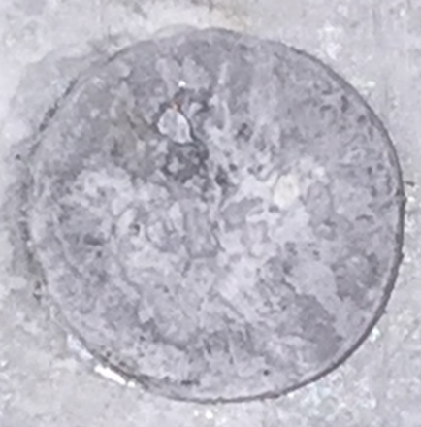
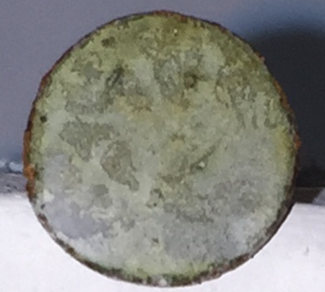
1: no corrosion observed
2: Edge corrosion only

Slide 5
3: Light partial surface corrosion
most scores of 3 would fail TAS criterion of > 5% surface corrosion
4: Light full surface corrosion

Slide 6
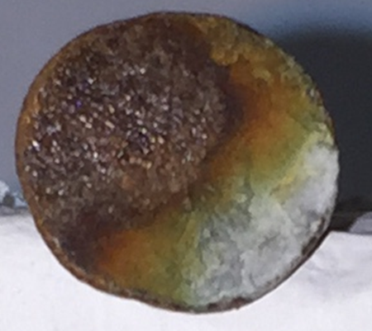
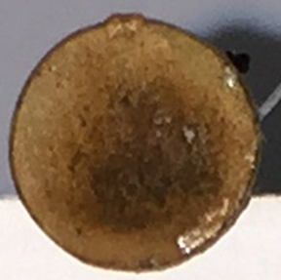
5: Partial heavy surface corrosion
6: Partial heavy and partial light full surface corrosion

Slide 7
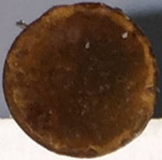
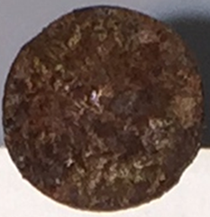
7: Heavy full surface corrosion without scaling
8: Heavy full surface corrosion with scaling

Slide 8
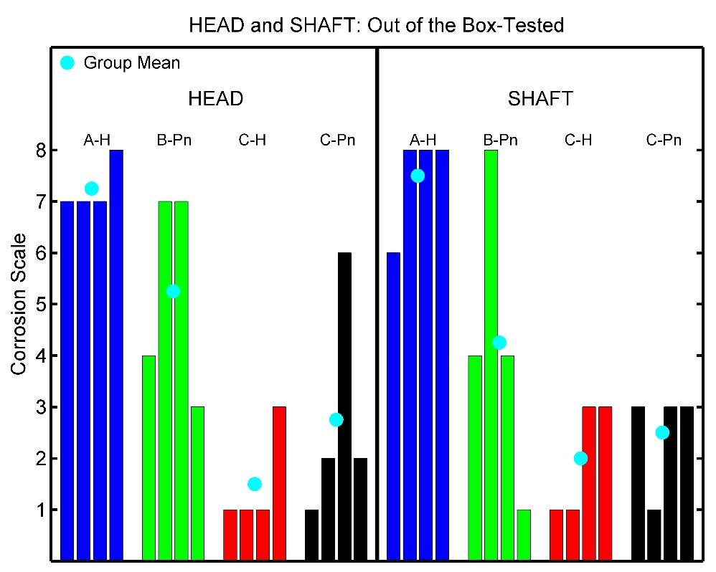
Results: 2014 - 2015
Corrosion scale results for 16 roof fasteners tested out of the box (configuration OB)
Manufacturers C & D clearly shows better performance
This set corresponds to the TAS 114 test specimen conditions

Slide 9
Results: 2014 - 2015
A wide disparity in the performance of electrogalvanized fasteners from different manufacturers was observed
A high failure rate of the TAS 114 criterion for electrogalvanized fasteners was observed
The tested fasteners were electrogalvanized, but not marked at ASTM A641 or TAS 114 compliant
The results provide a baseline against which to measure ASTM A641 and TAS 114 compliant fasteners
Are they any better than unlabeled EG fasteners?

Slide 10
2015 – 2016 Work
Goal: Determine whether ASTM A641 and TAS 114 Appendix E certified fastener performance exceeds the baseline electrogalvanized results from the 2014 – 2015 study
Approach: Apply TAS 114 Appendix E testing (Section 2.6.1) to evaluate the degree of corrosion resistance of ASTM A641 Class 1 fasteners and TAS 114 Appendix E certified fasteners

Slide 11
2015 – 2016 Work
Working with Mark Zehnal to identify and procure test specimens
1 ¼” EG nails, HVHZ and non-HVHZ CHINA
1 ¼” hot dipped coil nails CHINA
Note: hot dipped coating ~ 10 times thicker zinc coating than EG
3” stainless steel patio/deck nails TAIWAN
2 ½” Electroplated (EP) tile screws USA
2 ½” Mechanically galvanized tile screws USA
Note mechanically galvanized thicker zinc coating than electroplated
Hot dipped screws CHINA
Suppliers include north, central and south Florida
10 of each type were tested

Slide 12
2015 – 2016 Work
Table 1: 16 specimen types tested to date (10 samples of each)
Group number | Product type | Coating type | Certification | Supplier location
1 | 1 ¼ nail | EG | ASTM F1667 | Orlando
2 | 1 ¼ nail | EG | Unknown | Orlando
3 | 1 ¼ coil nail | EG | Unknown | Orlando
4 | 1 ¼ coil nail | EG | ASTM F1667 | Gainesville
5 | 1 ¼ coil nail | EG | ASTM A153 Class D | Orlando
6 | #8 2 ½ tile screw | MG | ASTM B695 Class 55 2006 IRC Compliant | Orlando
7 | #8 2 ½ tile screw | EP | unknown | Bradenton
8 | 1 ¼ coil nail | EG | ASTM F1667 | Bradenton
9 | 1 ¼ coil nail | HD | Unknown | Sarasota
10 | 1 ½ screws | HD | No info | No info
11 | 10d 3” RS | SS | MDC Approved HVHZ | Miami
12 | 1 ¼ RS nail | HD | MDC Approved ASTM F1667 HVHZ | Miami
13 | 1 ¼ nail | EG | MDC Approved ASTM F1667 HVHZ | Miami
14 | 1 ¼ coil RS nail | EG | MDC Approved ASTM A641 | Miami
15 | 1 ¼ coil RS nail | EG | Non HVHZ, MDC approved ASTM A641 | West Palm
16 | #8 2 ½ tile screw | MG | ASTM B695 Class 55 2006 IRC Compliant | West Palm
Notes: ASTM F1667 ➔ ASTM A641 compliant ASTM A153 Class D thicker zinc coating that ASTM A641 ASTM B695 ➔ mechanical galvanizing standard, Class 55 ➔ 0.0022” zinc thickness HVHZ ➔ Miami Dade County compliant EG ➔ electrogalvanized, EP ➔ electroplated, MG ➔ mechanically galvanized, HD ➔ hot dipped, SS ➔ stainless steel

Slide 13
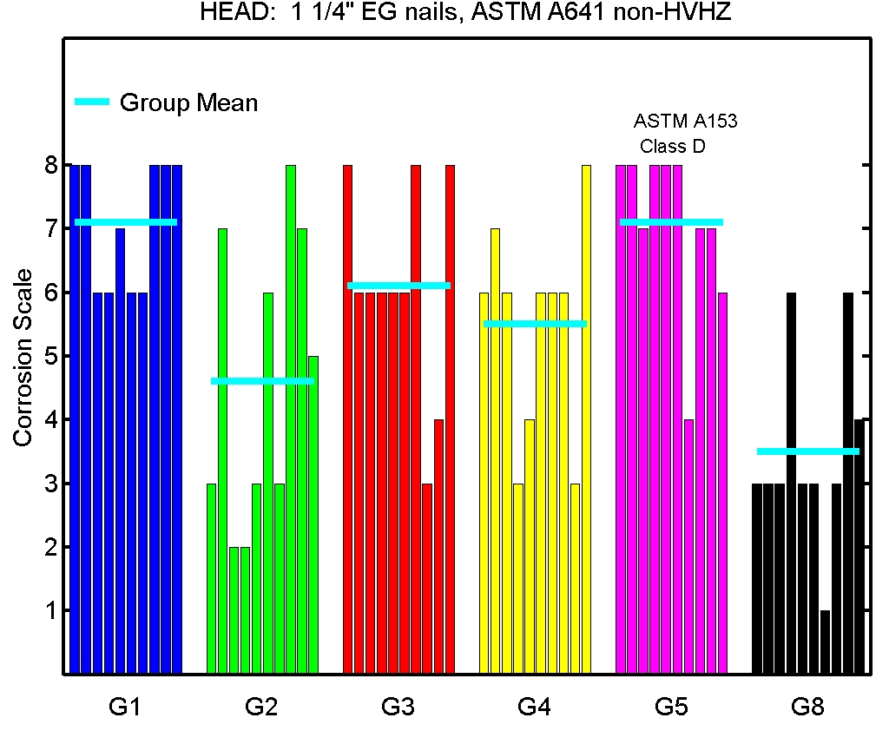
2015 – 2016 Work
Figure 1: All 1 ¼” electrogalvanized (EG) nails compliant with ASTM A641, non-HVHZ. Head results shown, shaft very similar
Generally, no improvement from
2014-2015 EG samples
Next graph: EG HVHZ

Slide 14
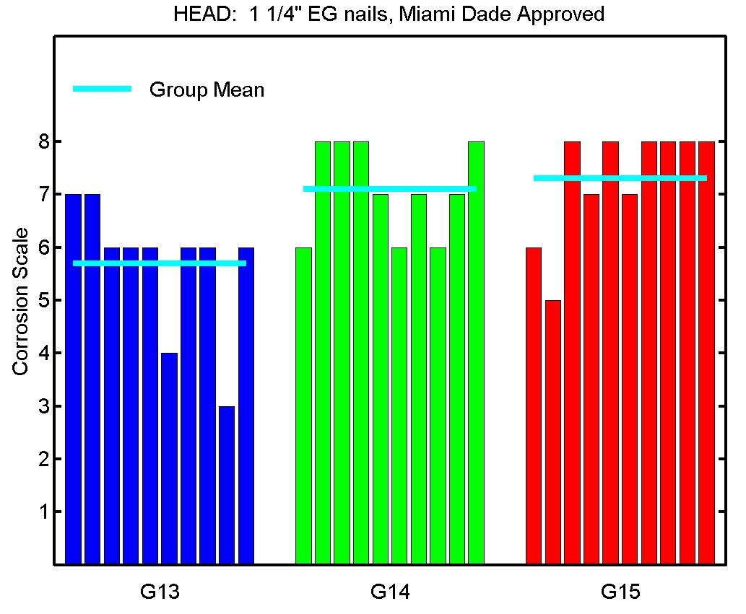
2015 – 2016 Work
Figure 2: All 1 ¼” EG nails compliant with ASTM A641, HVHZ approved. Head results shown, shaft very similar
HVHZ approved EG no better than
Non-HVHZ EG
Next graph: MG and EP tile screws

Slide 15
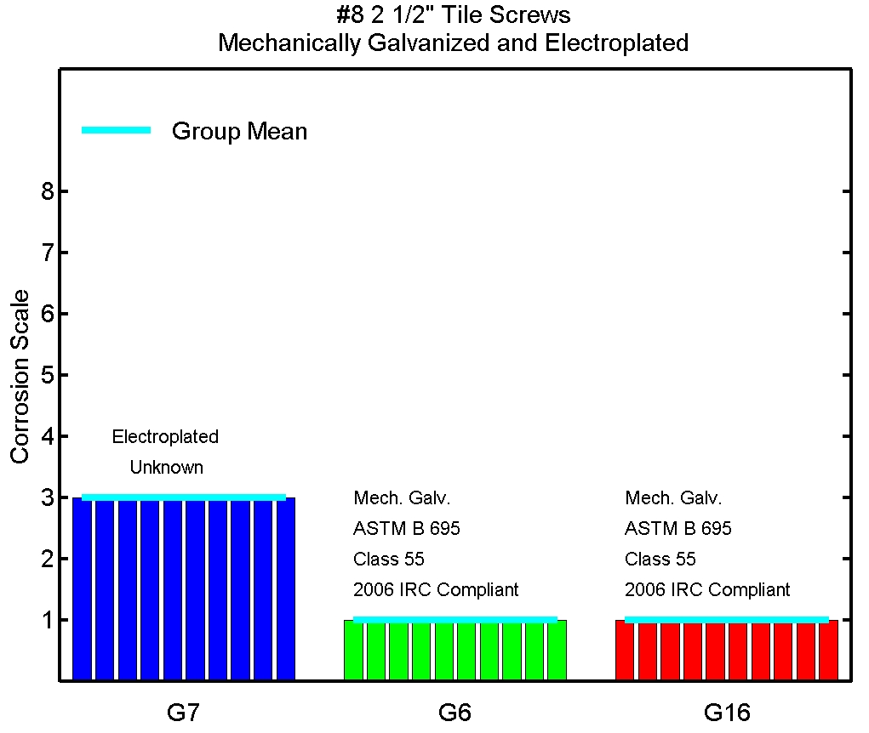
2015 – 2016 Work
Figure 3: #8 2 ½” roof tile screws, two mechanically galvanized specimens and one electroplated specimen. Head and shaft identical.
No visible corrosion on any
sample of MG tile screws
Next graph: Hot dipped and SS

Slide 16
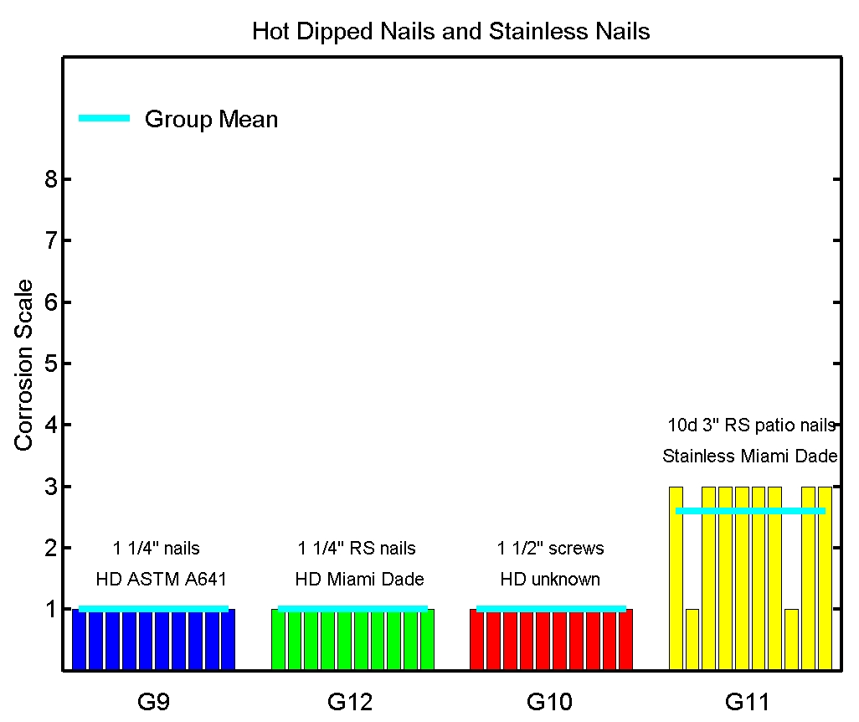
2015 – 2016 Work
Figure 4: Two hot dipped 1 ¼” nail specimens, one hot dipped 1 ½” screw enclosure fastener specimen, and one 10d 3” stainless steel patio/deck nail specimen. Head results shown. Shaft results identical.
No visible corrosion on any
sample of hot dipped fasteners

Slide 17
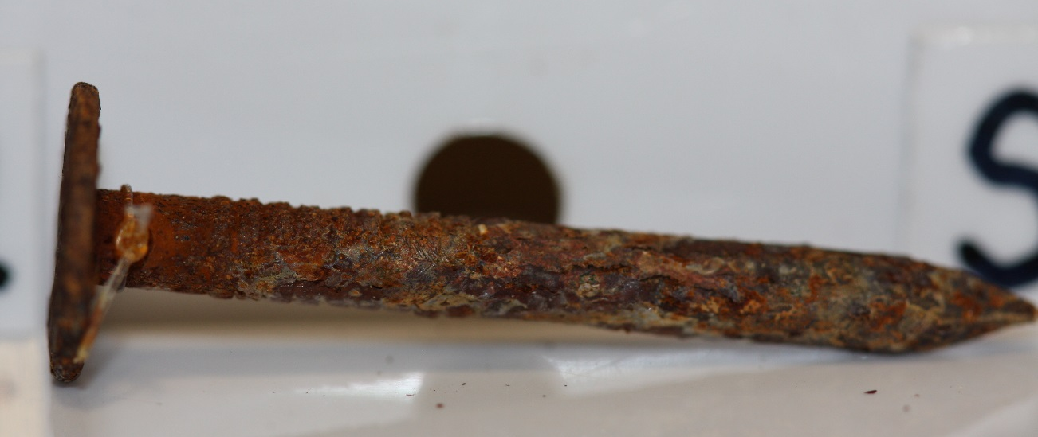
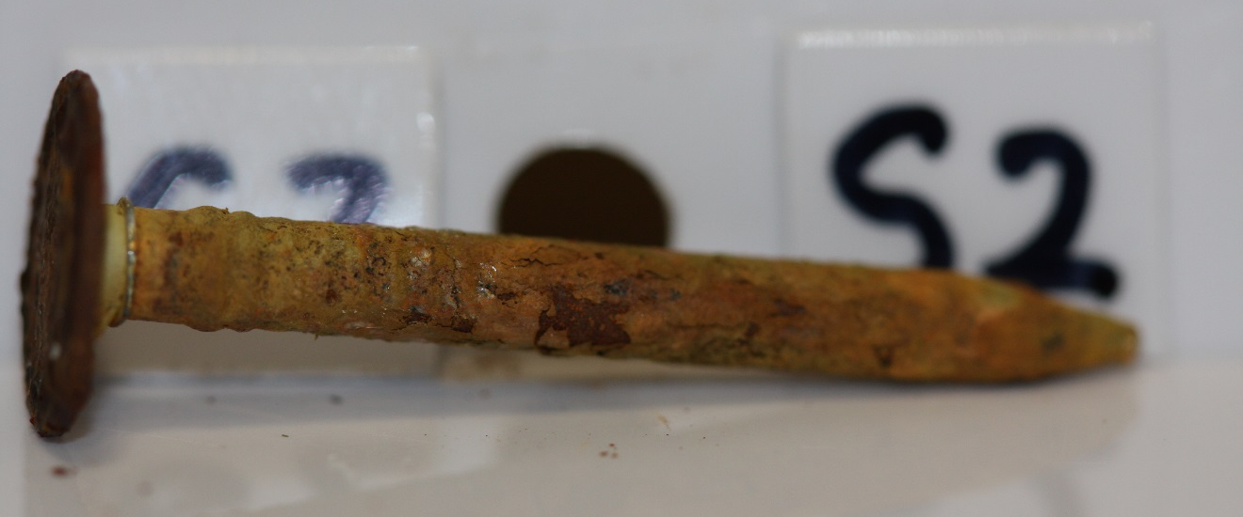
North Florida EG coil nail ASTM F1667 ➔ ASTM A641

Slide 18
North Florida EG coil nail ASTM A153 class D > ASTM A641

Slide 19
Central Florida EG coil nail ASTM F1667 ➔ ASTM A641

Slide 20
South Florida EG coil nail ASTM A641 HVHZ – Approved

Slide 21
Hot dipped nails

Slide 22
Central Florida hot dipped screws

Slide 23
North & South Florida mechanically galvanized tile screw

Slide 24
Central Florida electroplated tile screw

Slide 25
Stainless steel patio/deck nails

Slide 26
2015 – 2016 Work
Observations
ASTM A641 certified EG performance no better than unlabeled EG fasteners from the previous year’s study
HVHZ compliant EG fasteners (presumed TAS 114 E compliant) perform no better than non-HVHZ ASTM A641
Hot dipped fasteners perform much better than EG fasteners
Mechanically galvanized (MG) screws perform better than EP screws

Slide 27
2015 – 2016 Work
Observations
Miami-Dade approved EG fasteners: The results thus far did not reveal a single EG sample that passed the TAS 114E criterion of < 5% surface corrosion. Each of the 30 such fastener samples tested had a score of at least 3 (partial light surface corrosion) on both the head and shaft, and most samples displayed significant heavy corrosion
Requiring Miami-Dade approval for all EG fasteners used in Florida is not a viable code modification
To date, among all 244 samples tested (88 in phase 2, 160 in phase 3), only the hot dipped and mechanically galvanized specimens demonstrated no corrosion in any of the samples (30 hot dipped, 20 mechanically galvanized samples)

Slide 28
2015 – 2016 Work
Upcoming work
Procurement and testing of additional specimens
EG ASTM A641 and Miami-Dade approved
Seeking USA made 1 ¼” nail products
Testing installed/removed hot dipped specimens to investigate the suggestion that hot dipped treatment is more brittle than EG (FRSA member suggestion)

